Slide 1
What is Genocide?

Slide 2
What is Genocide?
1. “When is something killing versus genocide?
2. How do we measure it and define it?”
3. This is the “spectrum of violence.”
Least Harmful -------------------------------------------------------------- Most Harmful

Slide 3
Pretend that…..
This world is populated by two groups of people: the Purple People
and the Pink People.
Where on the spectrum you would place the following acts of violence:

Slide 4
Spitting on someone because they are Purple.
2. Calling someone a bad name because they are Purple.
3. Beating up a random Purple person walking down the street because they are Purple.
4. Passing a law to prevent all Purple people from getting jobs from Pink people.
5. Ransacking a neighborhood, breaking windows of houses and painting graffiti on Purple peoples’ houses.
6. Killing a Purple family because they are Purple.
7. Rounding up and taking all Purple people to a school yard and killing them

Slide 5
Definition: Genocide
A systematic extermination of a group of people on the basis of their
ethnicity, religion, or other defining characteristic.
Genocide has a few specific components
Systematic actions taken
To destroy or exterminate a group of people
Based on a specific characteristic of the group (such as race, religion, ethnicity)

Slide 6
Legal definition of genocide
Any of the following acts committed with intent to destroy, in whole or in part, a national, ethnical, racial or religious group, as such:
• Killing members of the group;
• Causing serious bodily or mental harm to members of the group;
• Deliberately inflicting on the group conditions of life calculated to bring about its physical destruction in whole or in part
• Imposing measures intended to prevent births within the group;
• Forcibly transferring children of the group to another group”

Slide 7
Brief Overview of What is Happening in Darfur:
Read the overview and find evidence of Genocide.
Use the web diagram

Slide 8
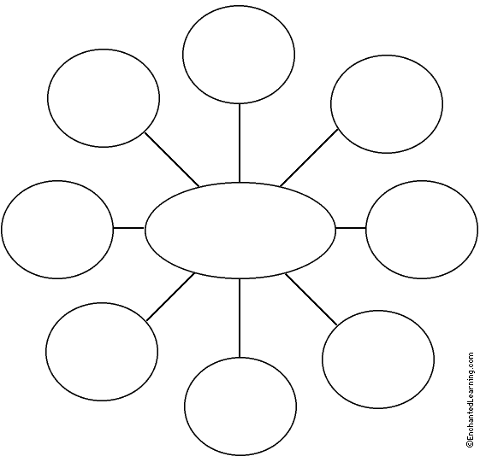
Evidence of Genocide
In Sudan

Slide 9
“A good man in Hell”
Rwanda genocide witness story.
http://www.dailymotion.com/video/x6t660_a-good-man-in-hell_news
Use SOAPS GRAPHIC ORGANIZER to take notes during the video.

Slide 10
Respond: Guiding questions:
Are there similarities between what is happening in Darfur today and what happened in Rwanda?
What lessons have we learned from what happened in Rwanda and how can they be applied to the current situation in Darfur?
Write these three terms on your notebook.
– “International”, “National”, and “Local”.
• What can be done to stop the genocide on each level. Begin with international and end with the local level.

Slide 11
RAISE AWARENESS
What YOU Can Do To Help Stop the Atrocities and Reduce the Suffering of the People of Darfur?
Help raise awareness of the genocide in your school and/or local community:
Design a T-shirts to be sale and use in a protest for the genocide in Sudan.

Slide 14
Exit Ticket:
From the Holocaust to Darfur: Have We Learned Our Lessons? Explain

