Slide 1
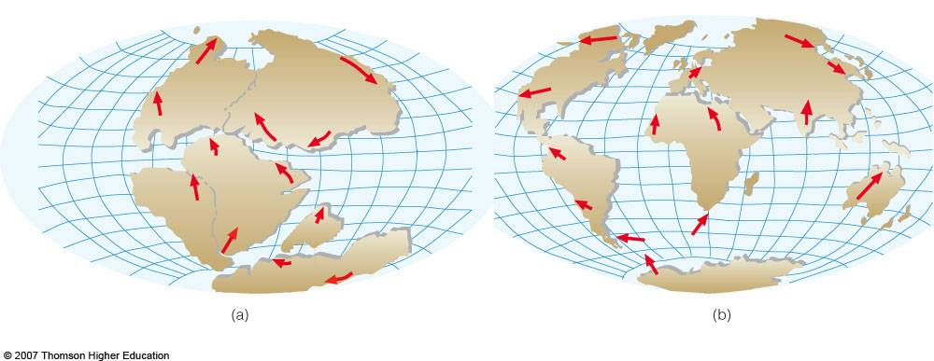
Plate Tectonic Theory
Warm up
Notes:
_________________________________________________________________
_________________________________________________________________
_________________________________________________________________
_________________________________________________________________

