Slide 1
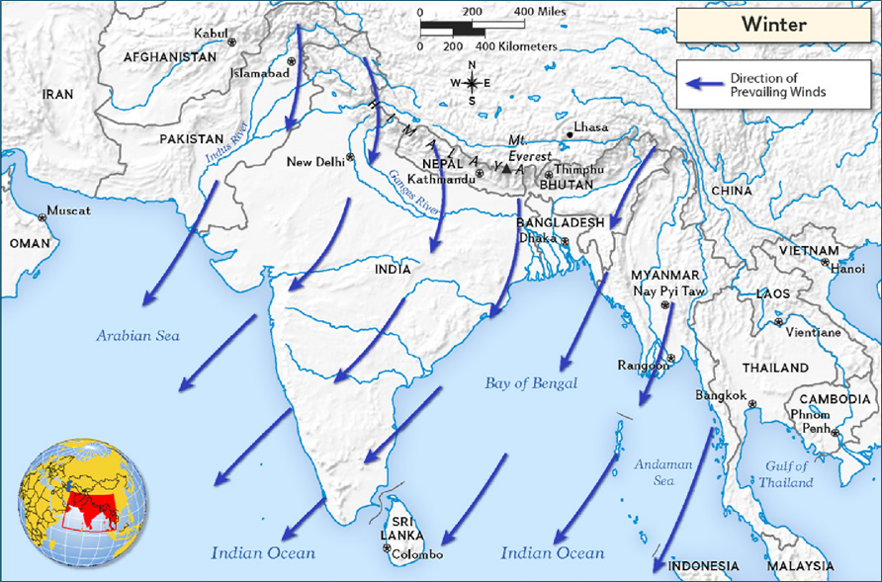
SOUTH ASIA’S MONSOONS:
HANDOUT 1

Slide 2
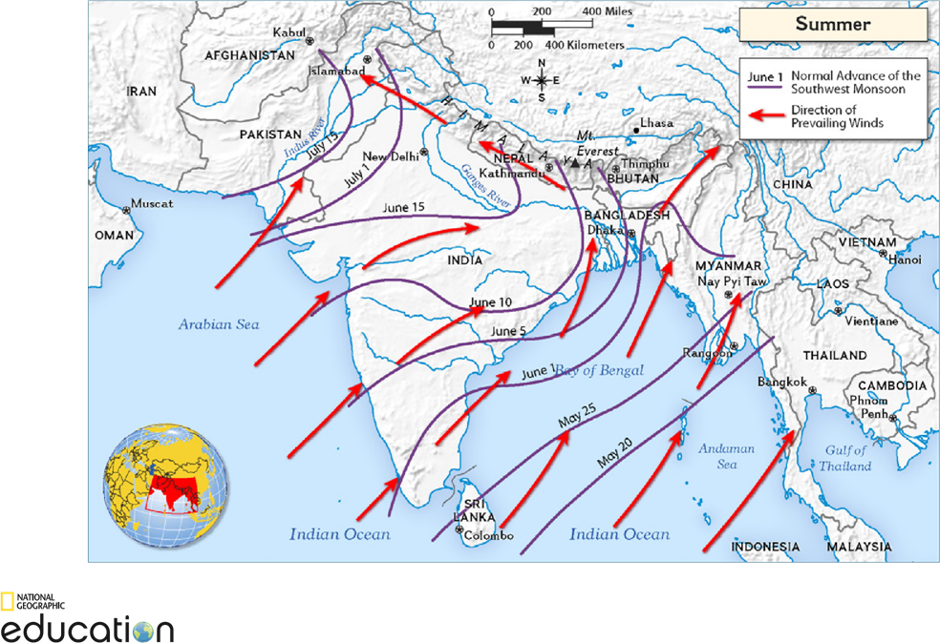

Slide 3
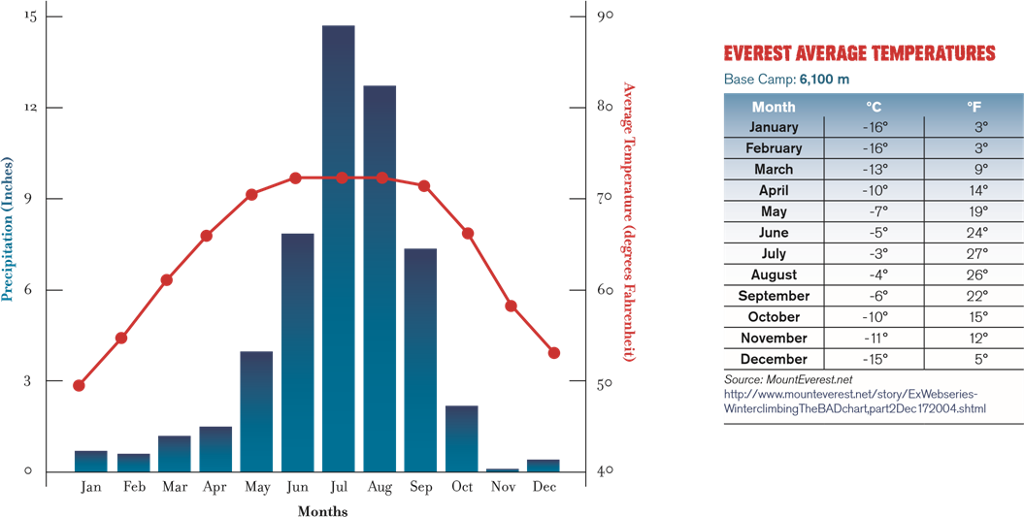
Analyze the information in the climograph below and the Everest temperature chart, then answer the questions below.
A CLIMOGRAPH OF KATHMANDU, NEPAL
Elevation: 1,400 m Absolute Location: 27.70°N 85.30°E

