Slide 1
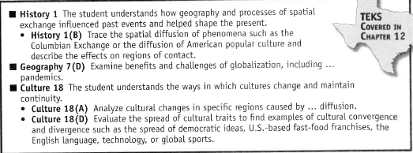

Slide 2
Vocabulary
Diffusion
Spatial Exchange
Columbian Exchange
Cultural Convergence
Cultural Divergence
Pandemics

Slide 3
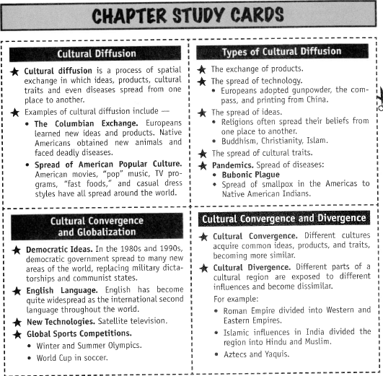

Slide 4
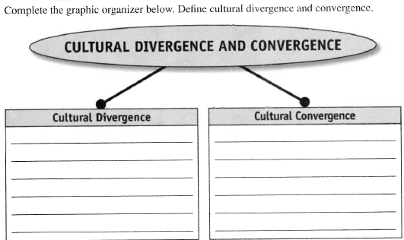
Name: _____________________________ Date:___________________

Slide 5
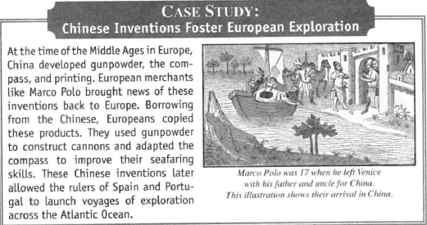

Slide 6
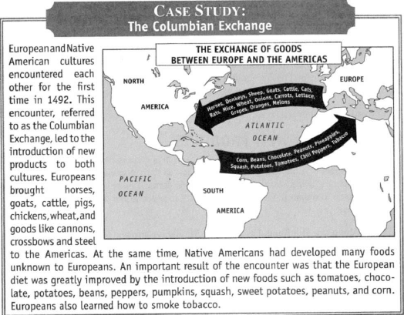

Slide 7
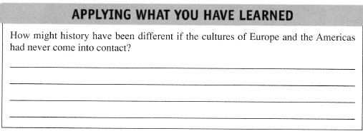
Name: _____________________________ Date: __________

Slide 8
2. The Spread of New Technologies

Slide 9
New Technology
Today, the spread of new products is especially rapid. People learn of new products through travel, newspapers, television, and telephone conversations. For example, personal computers did not exist before the 1980s. They were first developed in the United States, but they quickly spread through the world.

Slide 10
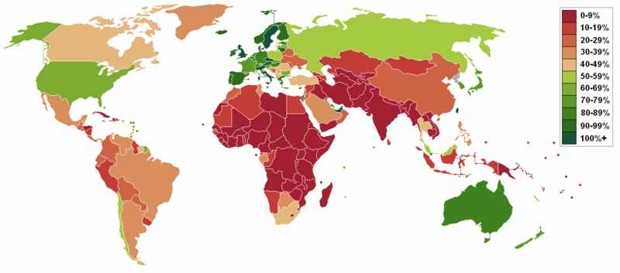
The Spread of New Technologies Cellular (mobile) Phones.

Slide 11
New Technology:
Even more recently, scientists and engineers developed cellular (mobile) phones. These have spread rapidly even to less developed nations, which lack enough telephone cables for landline telephones. In just a few years, cellular phones have spread from America, Japan, and Europe to every region of the world.

Slide 12
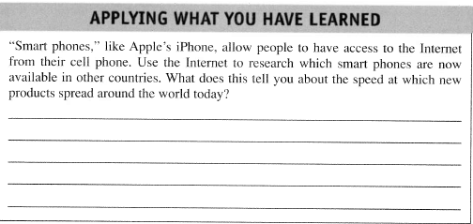
Name: _______________________________ Date: _____________
Your phone

Slide 13
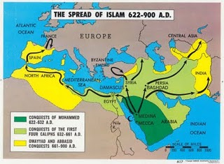
3. The Spread of New Ideas

Slide 14
New Ideas:
Contacts between different cultures can also lead to important exchanges of ideas. Religious beliefs, political ideas (like democracy) and other ideas often spread from one culture to another. The great world religions all spread from their places of origin to neighboring areas. Islam, for example, arose on the Arabian Peninsula. Arab peoples then brought Islam to the rest of the Middle East, North Africa, and Spain. Later, Islam spread to parts of South and Southeast Asia.

Slide 16
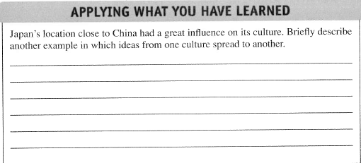
Name: _________________________________ Date: _______________

Slide 17
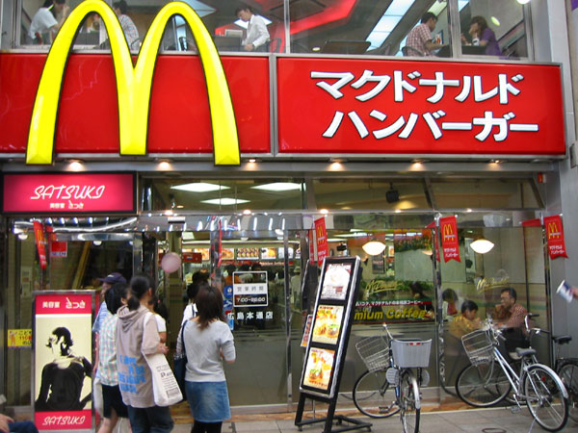
4. The Spread of Cultural Traits

Slide 18
Cultural Traits:
Even such elements of culture as clothing fashions, art styles, ways of cooking food, and music can spread from one region to another. Walk down the streets of any American city and you might find Italian and Chinese restaurants or women wearing shoes based on styles from Europe.

Slide 19
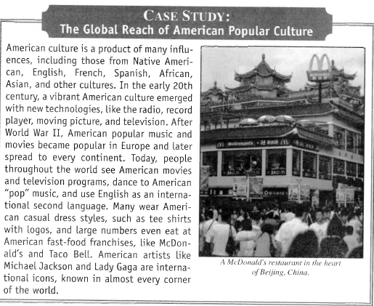

Slide 20
Name: ________________________________ Date: _____________

Slide 21
5. Pandemics: The Spread of Disease
We often think of the diffusion of a new phenomenon as beneficial, but it can sometimes have negative effects. One example of this is the spread of new diseases from one culture to another. The disease diffuses as the microorganisms that cause the disease are spread.

Slide 22
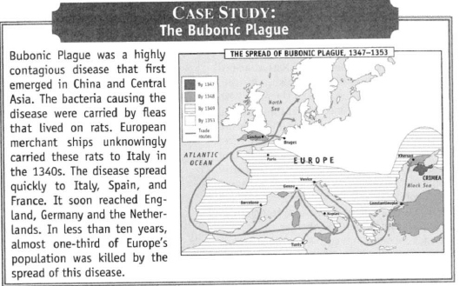

Slide 23
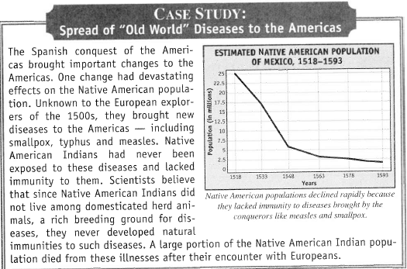

Slide 24
Pandemics
Today, we live in an increasingly interconnected world. People travel more than ever on airlines that reach every corner of the globe. In addition, our global food supply plays a role in the spread of disease. Mass production and the global distribution of foods make it easier from some illnesses to spread.

Slide 25
Pandemics:
New diseases are therefore emerging at an unprecedented rate. Often they have an ability to cross borders rapidly and spread from one country to another. Some scientists fear a pandemic flu, a new strain of influenza that might lead to a global pandemic (an epidemic over a wide geographic area).

Slide 26
