Slide 1
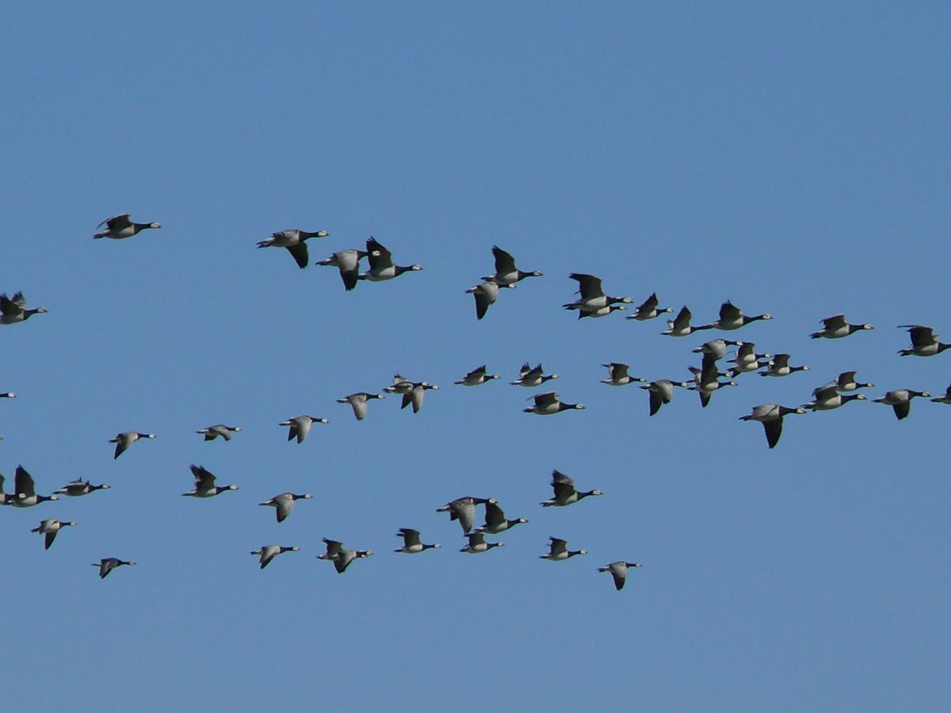

Slide 4
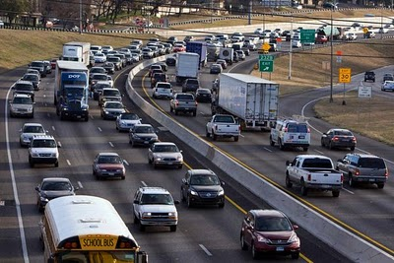

Slide 5
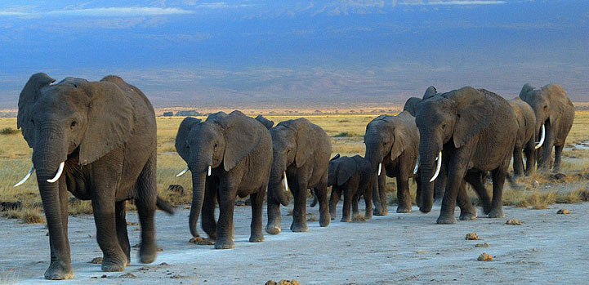

Slide 6
What do you see?
• What makes you say that?
• What more can we find?
What do you see?
• What makes you say that?
• What more can we find?
What do you see?
• What makes you say that?
• What more can we find?
What do you see?
• What makes you say that?
• What more can we find?

