Slide 1
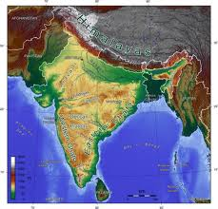
Lesson 1: Geography of India
World Geography Textbook Page 616

Slide 2
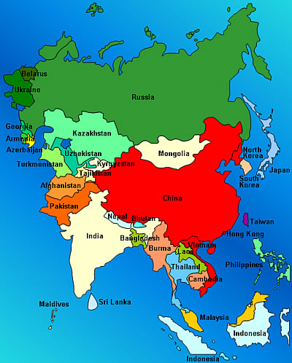
1. India is located on what continent?
ASIA

Slide 3
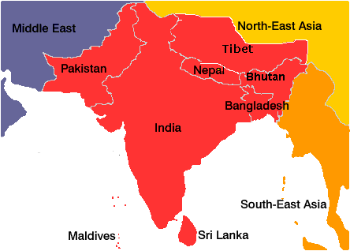
2. India is a ____________or a large landmass that is smaller than a continent.
Subcontinent

Slide 4
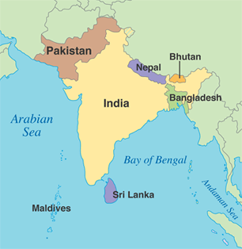
3. Which 7 countries are located on the Indian Subcontinent?

Slide 5
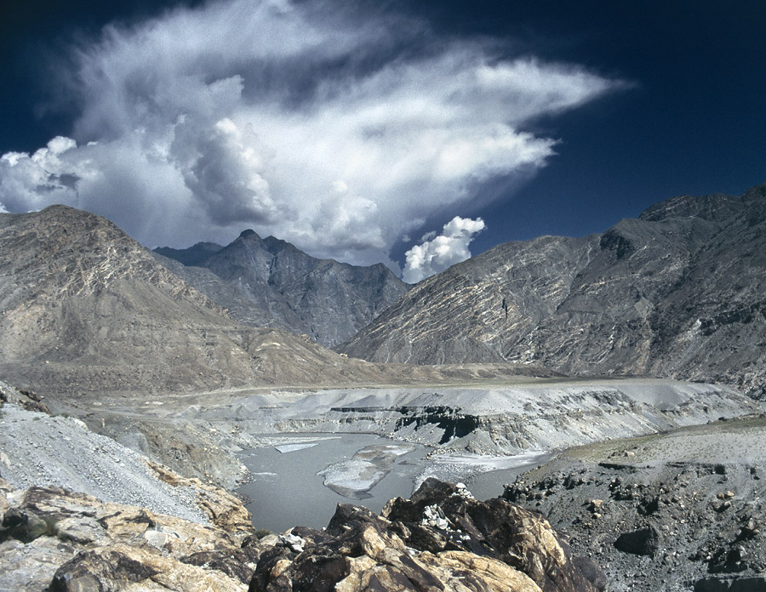
4._______________________ separates the Indian Subcontinent from the rest of Asia
Himalayas / Hindu Kush

Slide 6
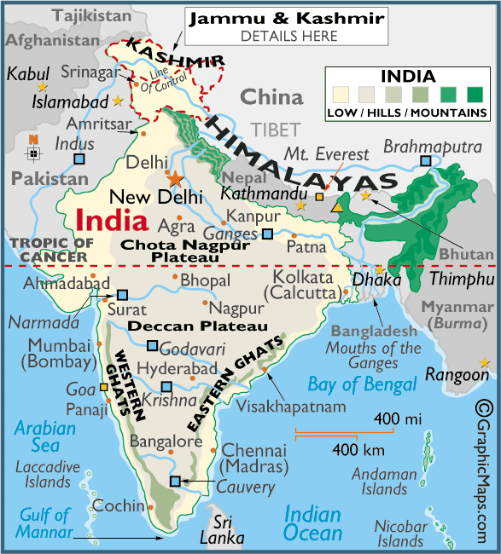
5. Which 4 mountain ranges are located in India?
Hindu Kush
Himalayas
Eastern Ghats
Western Ghats

Slide 7
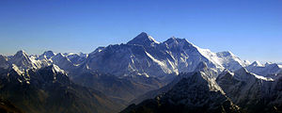
6. On the border between Nepal and China is ___________________ the highest Mountain on earth
Mount Everest

Slide 8
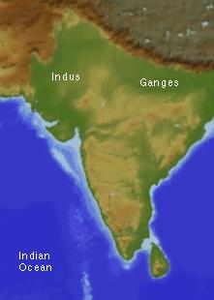
7. Deep in the Himalayas are the source of some of Asia’s mightiest rivers. 2 major river systems _________&________ originate in the Himalayas.
Ganges
Indus

Slide 9
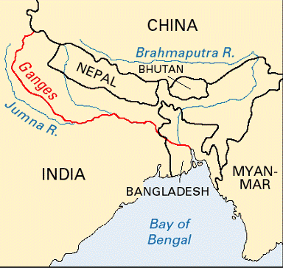
8. Where is the Ganges river Located?
Northern India

Slide 10
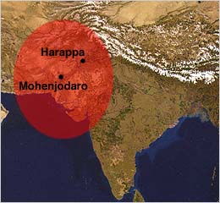
9. Indus River also creates a fertile plain known as the _________________. This Valley was once home to the earliest Indian civilizations.
Indus River Valley

Slide 11
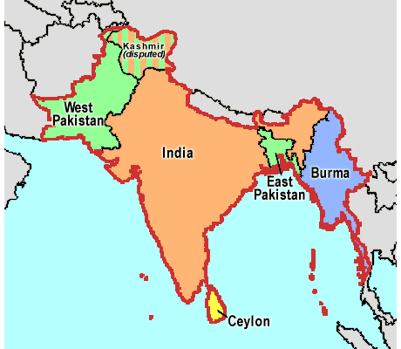
1. a. Define – What is a subcontinent?
A large landmass that is smaller than a continent

Slide 12
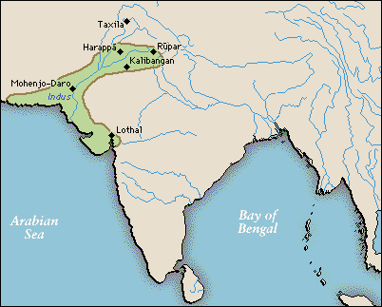
1. b. Make Inferences – Why do you think the Indus River Valley is so heavily populated?
The Indus River Valley has a good source of water and has fertile soil for farming.

Slide 13
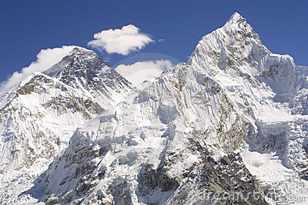
1. c. Rank – Which physical features in the Indian Subcontinent would you most want to visit? Why?
Answer may vary

Slide 14
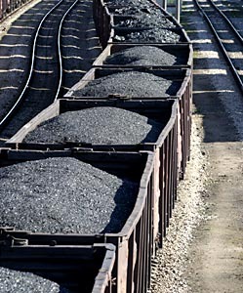
2. a. Identify – What natural resources are found in the Indian Subcontinent?
Agricultural and Mineral resources being the most plentiful.

Slide 15
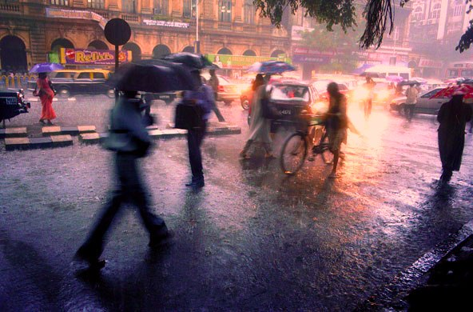
2. b. Analyze – What are some of the benefits and drawbacks of monsoons?
Benefits – rain allows for farming and drinking water; Drawbacks floods can kill people and destroy property

Slide 16
3. Drawing Inferences – Using your notes, write a sentence explaining how each aspect affects life on the Indian Subcontinent.
 | Effect On Life
Physical Features | The Geographical features that separate this region and its people from the rest of Asia makes it unique
Climates | The wide variety of climates affect daily life with many people depending on the summer monsoon for rain for Farming
Natural Resources | With lots of fertile soil ; the region’ farmers produce many different crops, including tea, rice, nuts, and Jute

