Slide 1
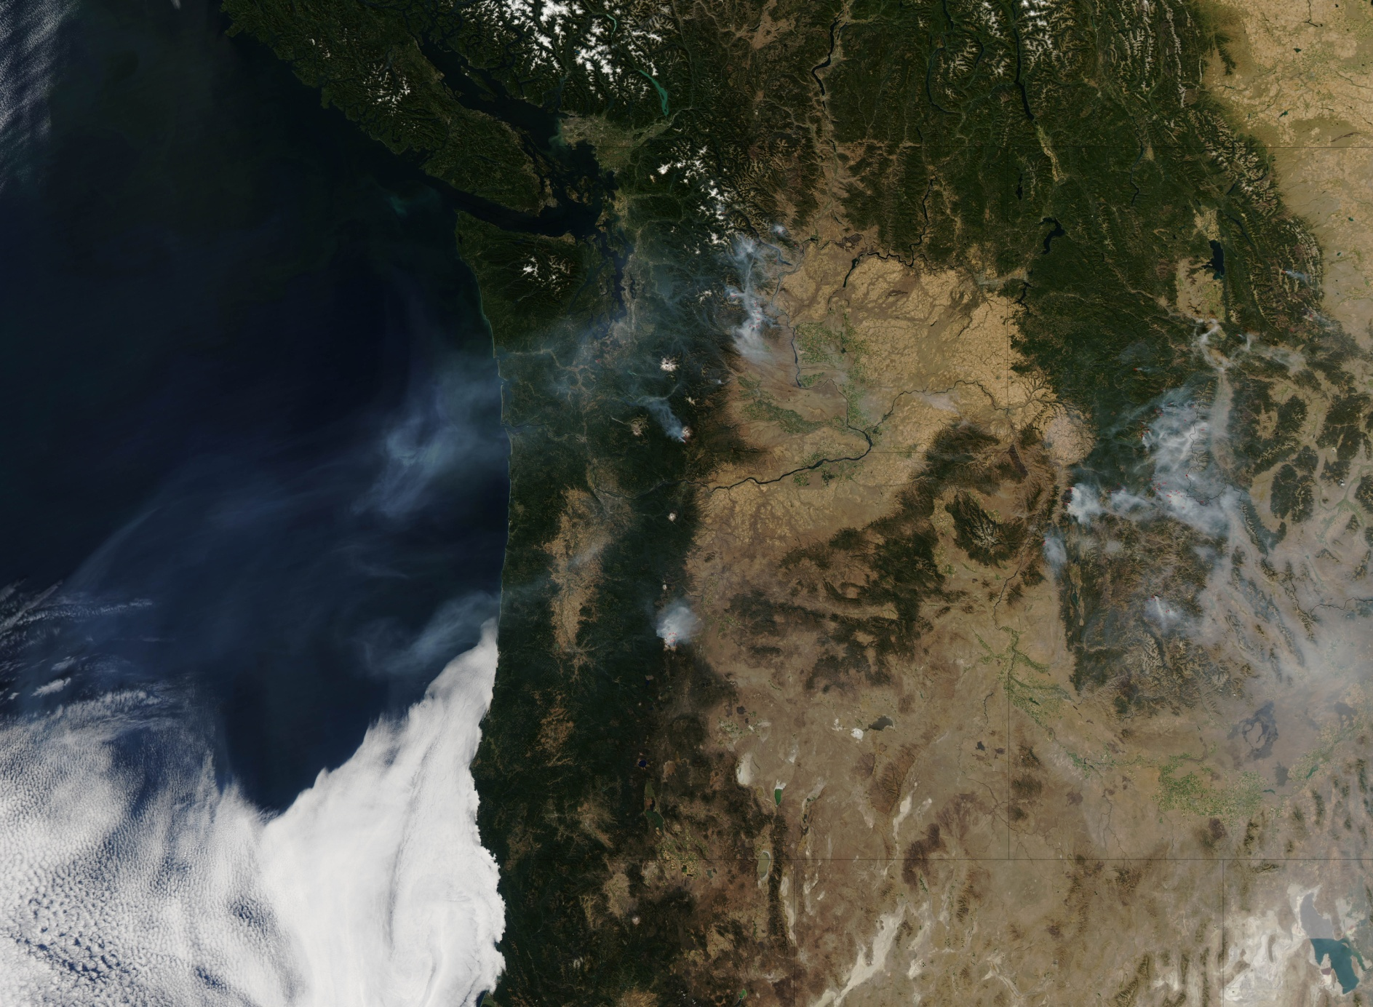
American West Continues to Burn
September 19, 2012

Slide 2
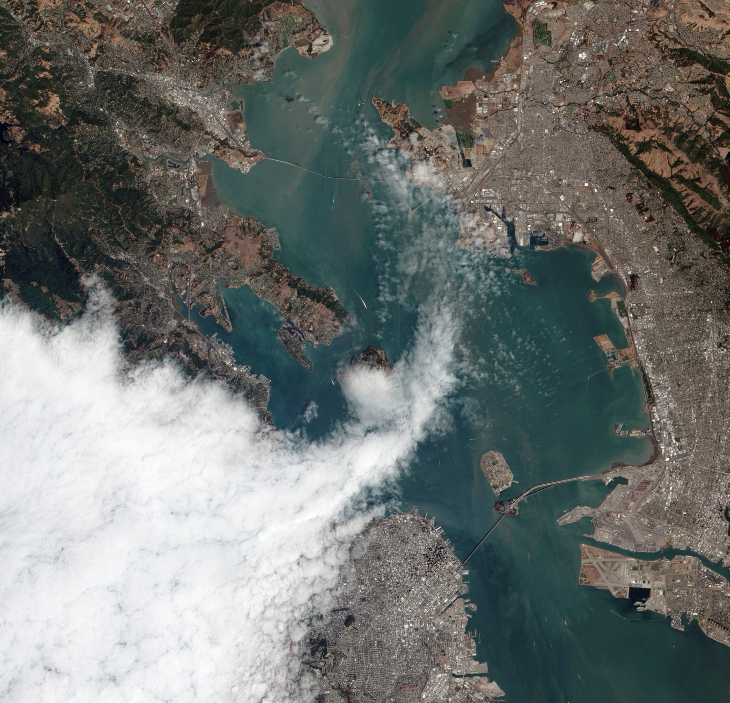
Another Foggy Day in San Francisco
September 11, 2012

Slide 3
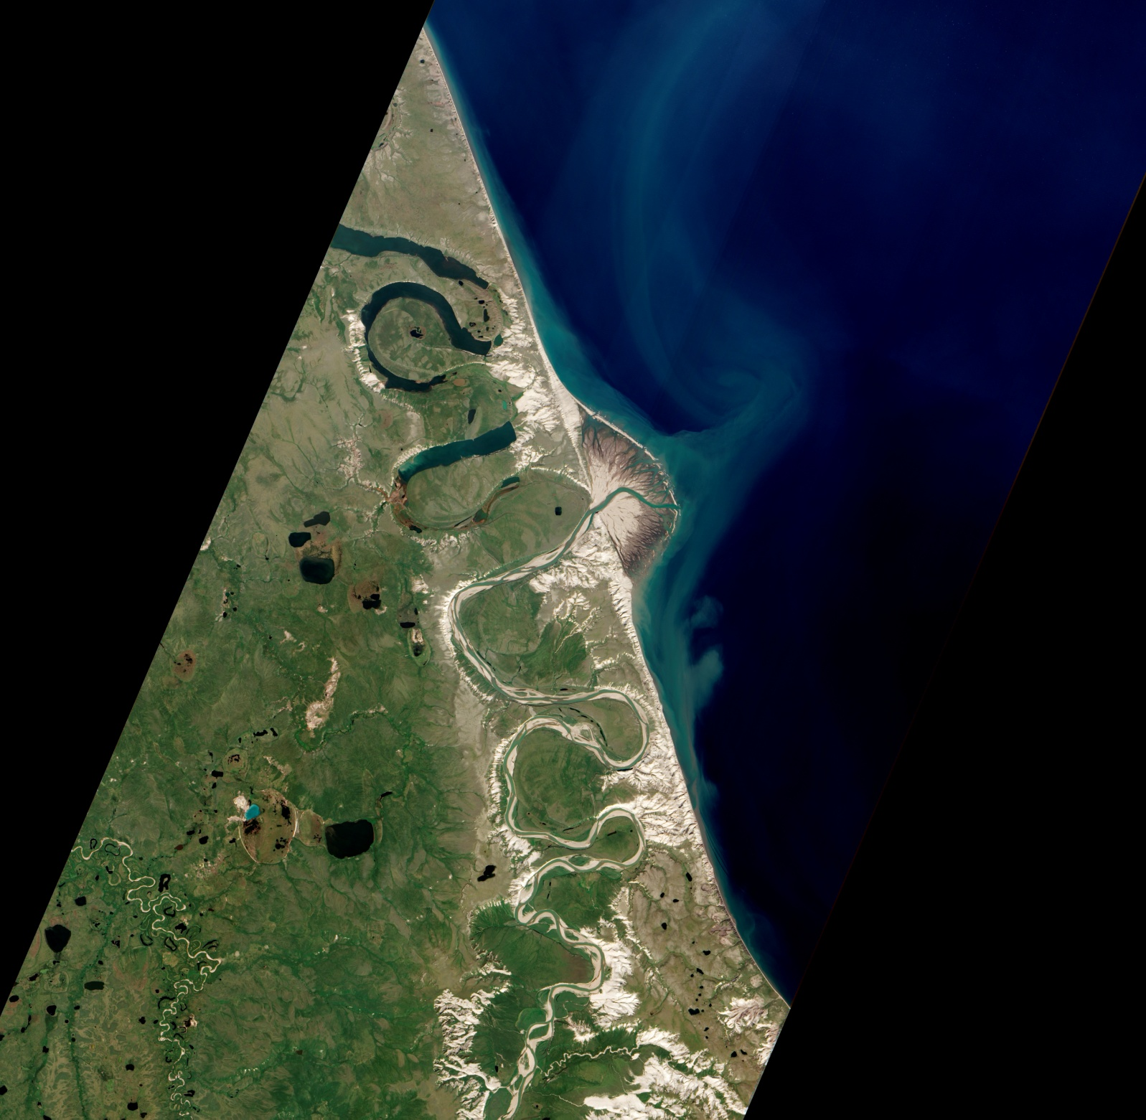
Horton River Delta, Arctic Canada
September 4, 2012

Slide 4
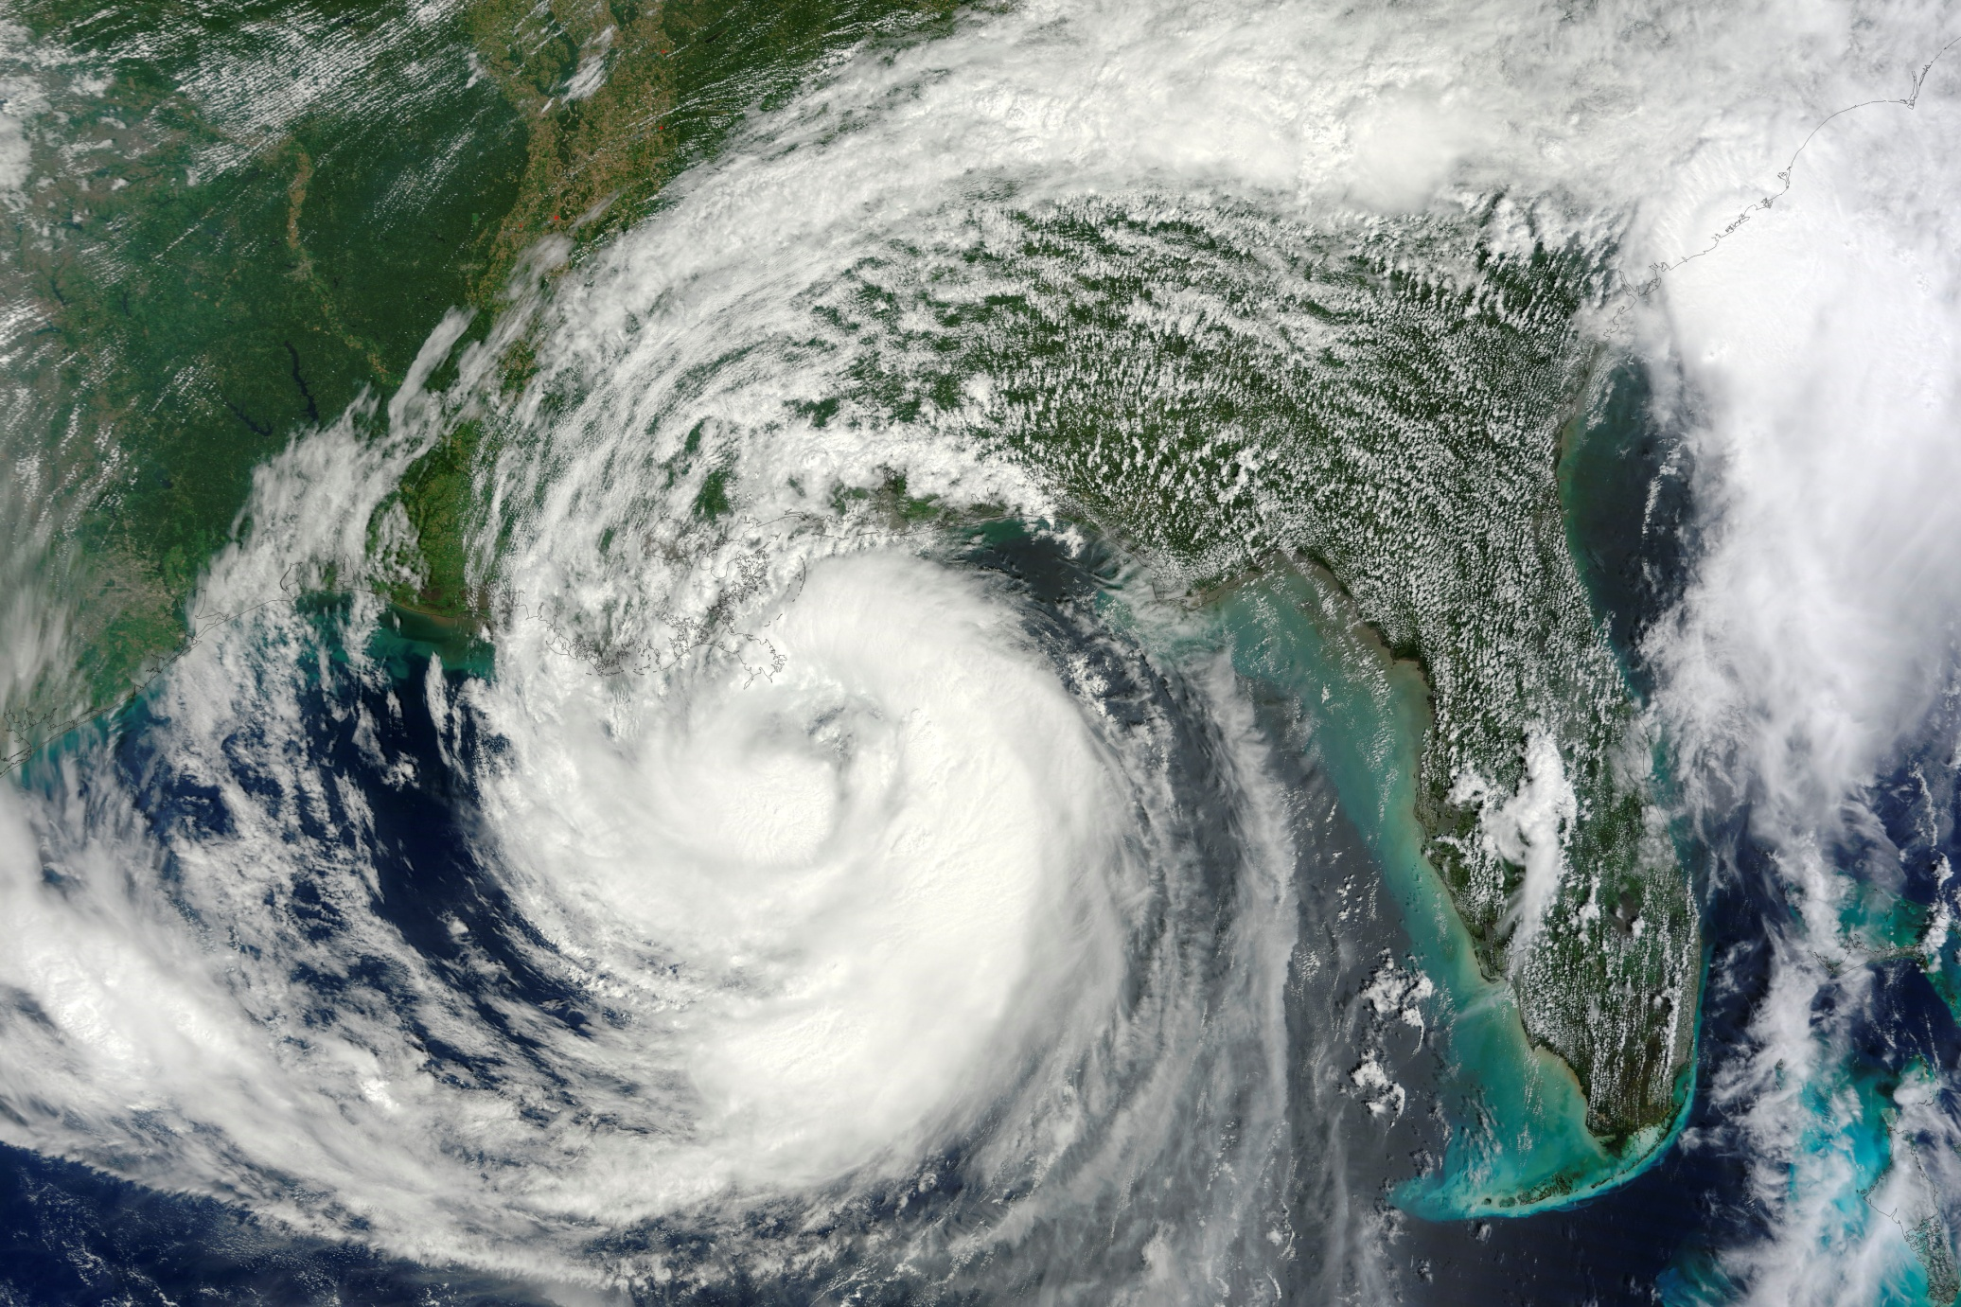
Hurricane Isaac
August 29, 2012

Slide 5
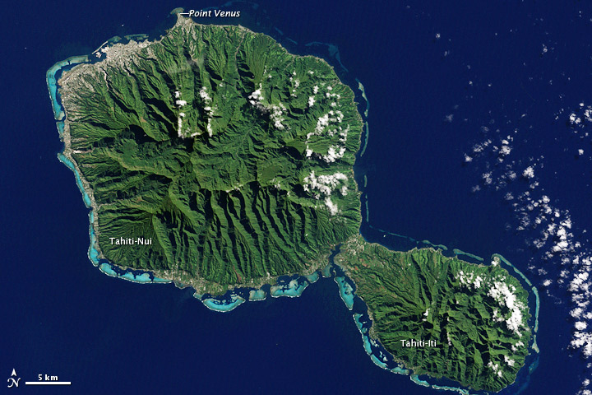
Tahiti, French Polynesia in Oceania
June 10, 2012

Slide 6
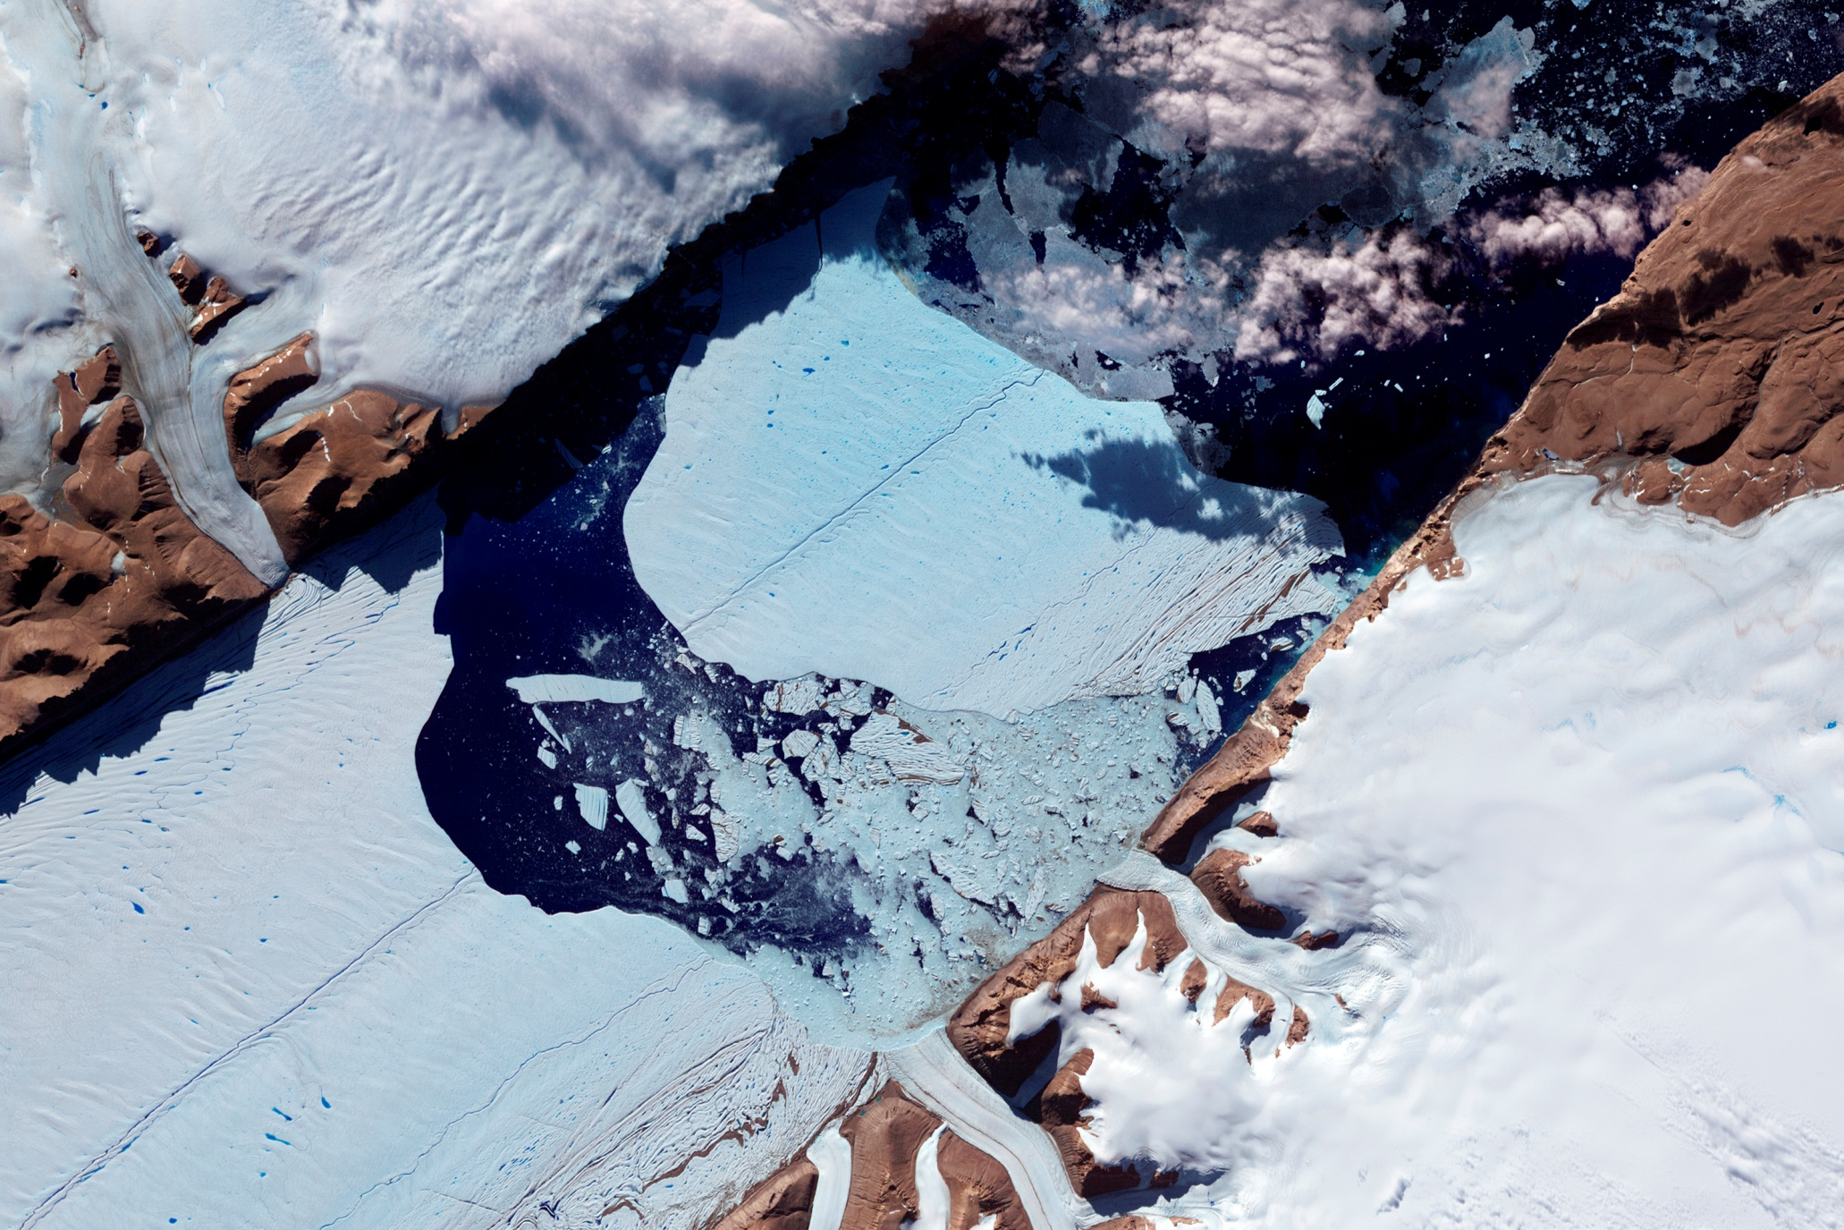
Closeup of the Ice Island from Petermann Glacier

Slide 7
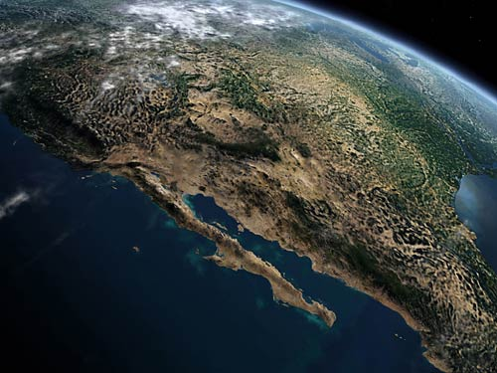
Closer look to Baja California

Slide 8
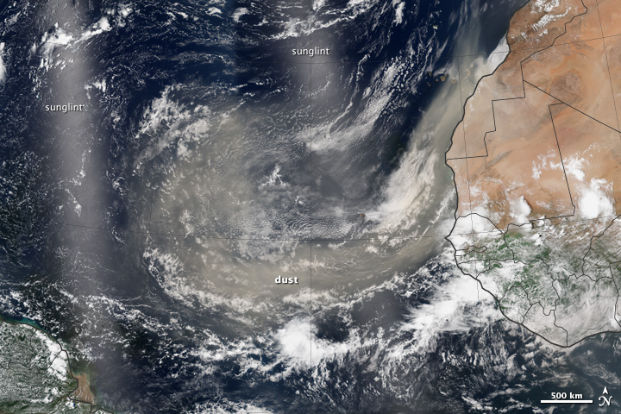
Tracking Dust Across the Atlantic
August 29, 2013

