Slide 1
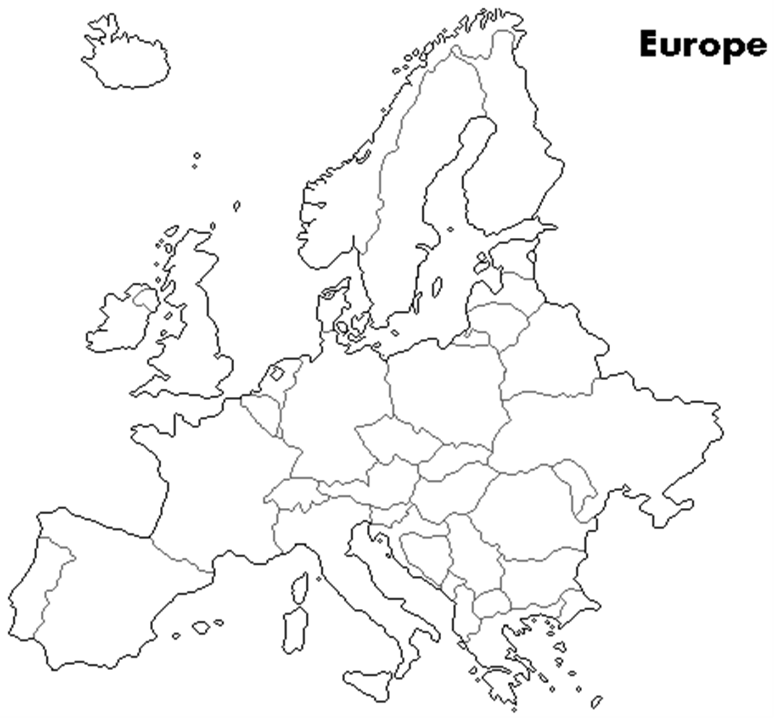
Review the following:
Countries location
Oceans and seas
Mountains
Major rivers
Changes in Europe before
And after WW1 and WW2.

Slide 2
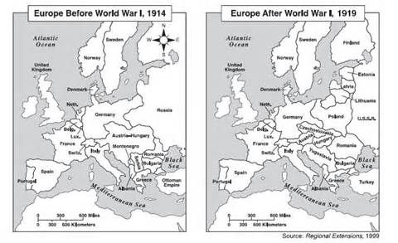

Slide 3
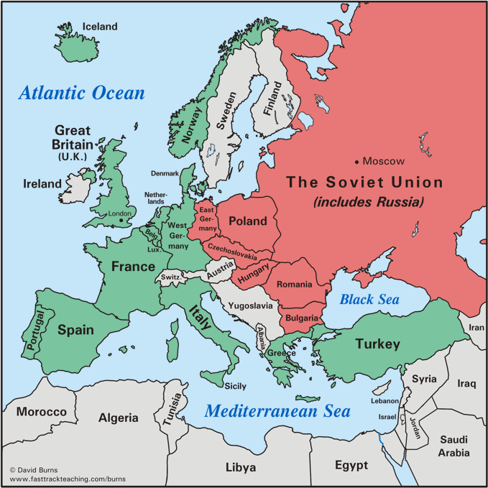
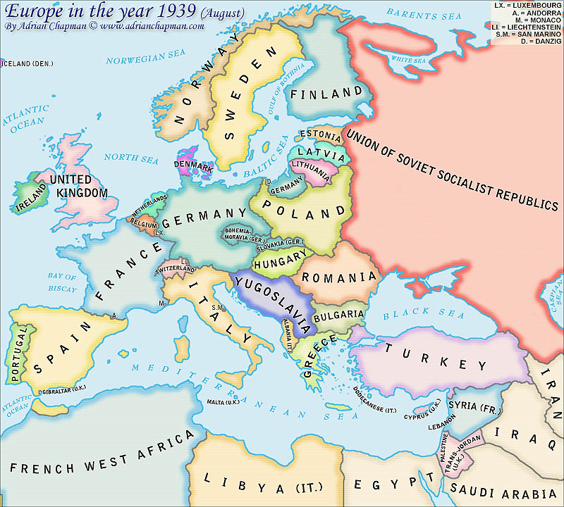
World War II
Before WW2
After WW2
1945

Slide 4
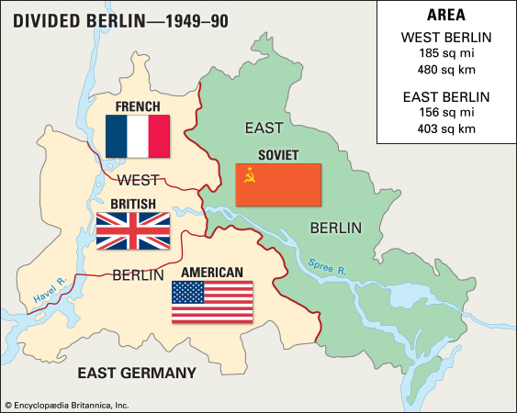

Slide 5
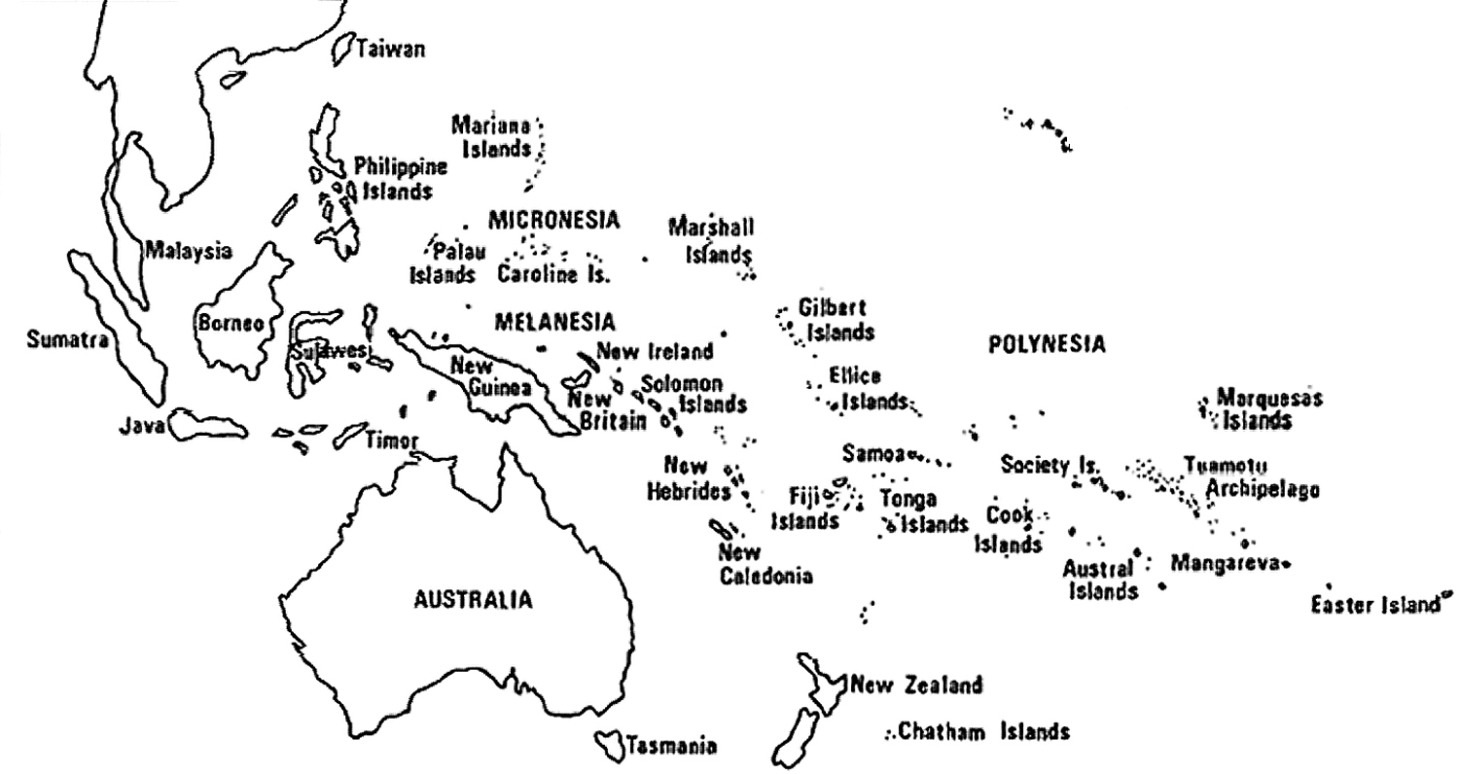
WW 2: The Pacific War Map

