Slide 1

European Union Part: Dos

Slide 2
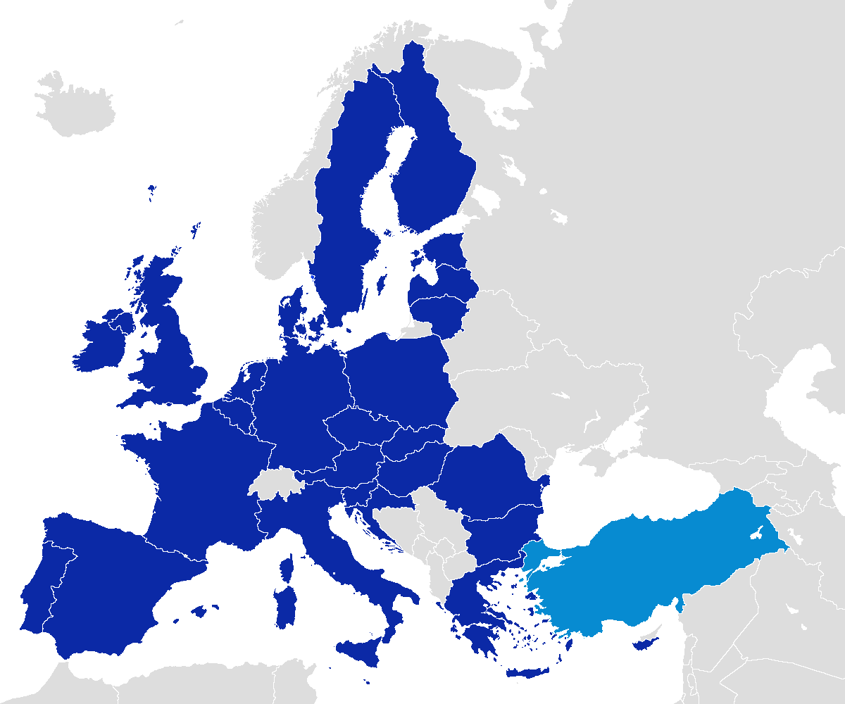
EU Refresher
http://www.tubechop.com/watch/8849418

Slide 3
Be a part of the Union
Using the conditions for EU membership, study your “potential candidate” country’s history and write a letter explaining what your country is doing in order to meet all criteria for EU membership.
https://ec.europa.eu/neighbourhood-enlargement/policy/conditions-membership_en
Countries:
Albania
Serbia
Turkey

Slide 4

Brexit: why did England leave?
http://www.tubechop.com/watch/8849479

