Slide 1
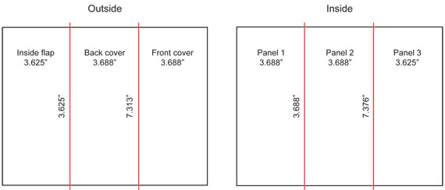
What is a
Hurricane?
What damage
A Hurricane can
Do?
Preparation
Checklist
Hurricane
Classification
Preparedness:
Before
During
After
Preparedness:
Before
During
After
Draw
Title
Name
Hurricane
Watch and
Warning

