Slide 1
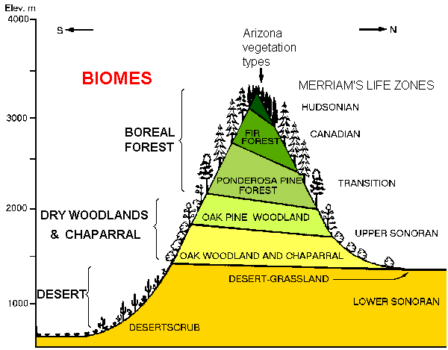
Level of the SEA

Slide 2
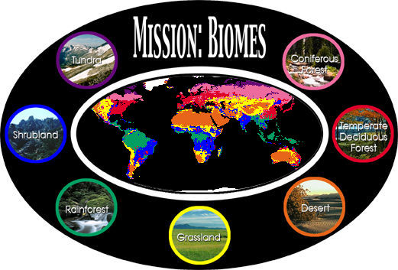

Slide 3
Tundra
WORLD BIOMES
Coniferous
Forest
Shrubland
Temperate
Deciduous
Forest
Rainforest
Grassland
Desert

Slide 4
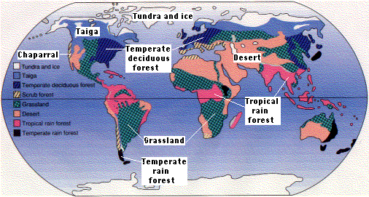

Slide 5
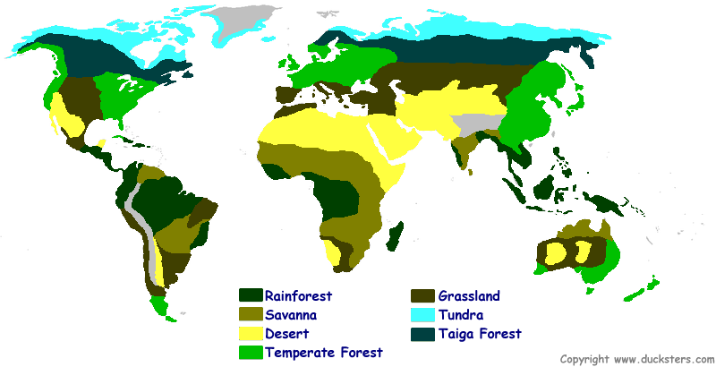

Slide 6
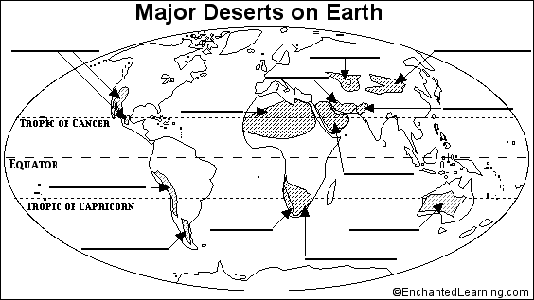

Slide 7
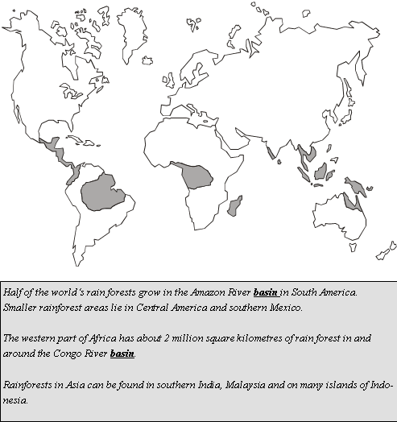
Major Rainforest on Earth
Major Rainforest

